Slide 1
COMPUTER NETWORK
A collection of autonomous computers interconnected by a single technology.
Uses of Computer Networks
Business Applications
Home Applications
Mobile Users
Social Issues

Slide 2
Services provided by the n/w to organizations
Resource Sharing
High Reliability
Cost
Scalability
Communication Medium
Services provided by the n/w to people
Access to remote information
Person-to-person communication
Interactive entertainment

Slide 3
Network Technologies
Broadcast Networks: All stations share a single communication
channel
Point-to-Point Networks: Pairs of hosts (or routers) are directly
connected
Typically, Local Area Networks (LANs) are broadcast
&
Wide Area Networks (WANs) are point-to-point

Slide 4
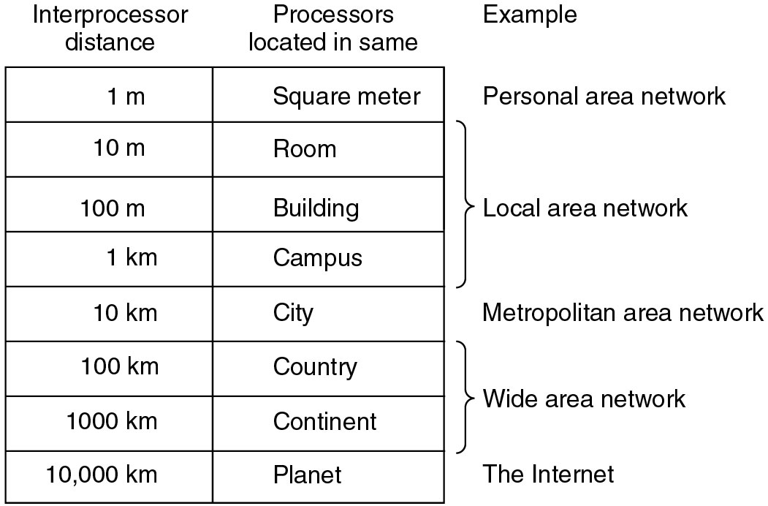
Network classification

Slide 5
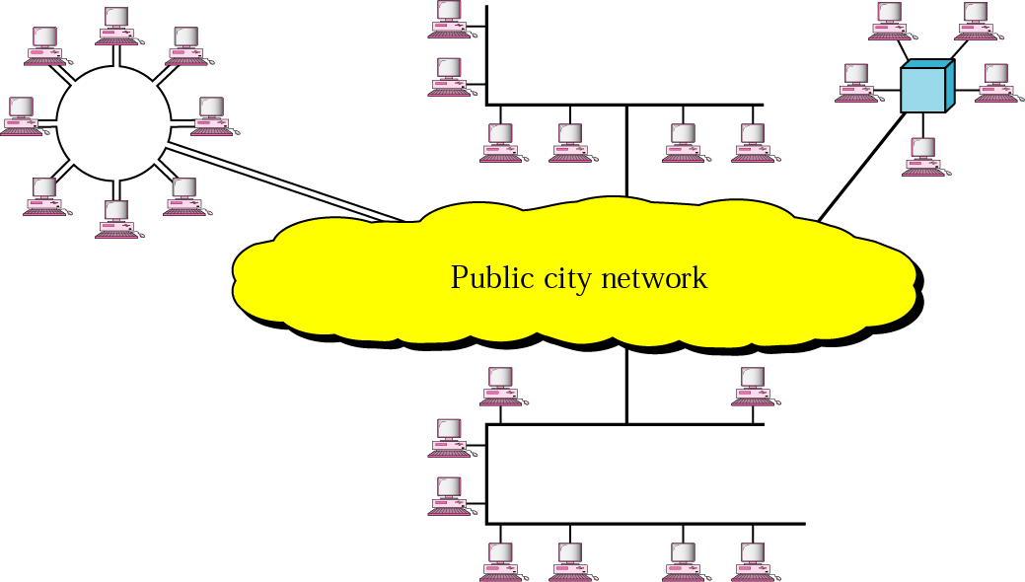
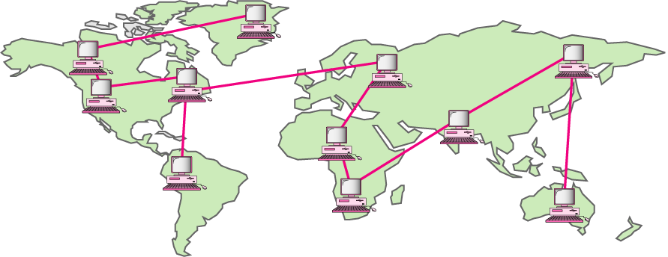
Local Area Networks:
Metropolitan Area Networks:
A metropolitan are network based on cable TV
Wide Area Networks:

Slide 6
SN. | LAN | WAN | MAN
1 | Private n/w | Private or public n/w | Private n/w
2 | Small area covered | Very large | Moderate city
3 | Design & maintence easy | Not easy | Not easy
4 | Coaxial cable | Satellite links | Coaxial cable, Optical fiber
5 | Data rate : high | Low | Moderate
6 | Propagation Delay: Short | Long | Moderate

Slide 7
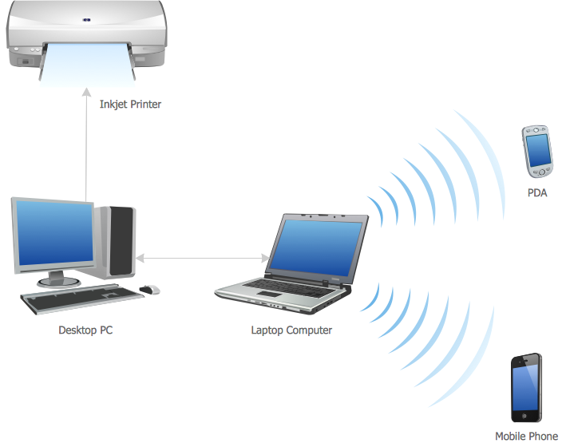
Personal Area Network:

Slide 8
Ad-hoc Network: Collection of wireless mobile nodes (devices) dynamically forming a temporary network without the use of any existing network infrastructure or centralized administration
Comparison: Infrastructure vs Ad-hoc networks
WLANs can be classified into two types:
Infrastructure networks contains access points (APs) and mobile station (STAs).
Ad hoc LANs do not need any fixed infrastructure.
Infrastructure networks
Provide access to other networks
Include forwarding functions
Medium access control
Ad-hoc networks is a group of computers each with wireless adapters, connected as an independent wireless LAN.
Each node can communicate with other nodes

Slide 9
Comparison: infrastructure vs. ad-hoc networks
Infrastructure Network
AP: Access Point
AP
AP
Wired network
AP
Ad-hoc network

Slide 10
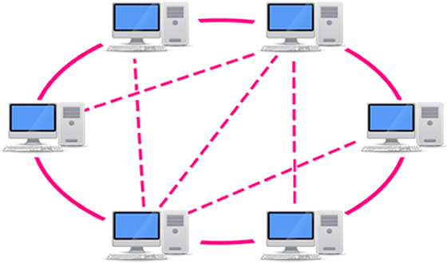
Network Architectures
Network architecture describes the allocation of tasks between computers in a network.
Peer-to-Peer :
No hierarchy and all are equal.
File sharing – Napster, BitTorrent

Slide 11
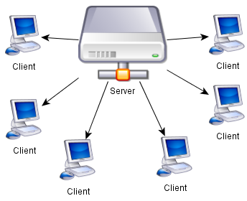
Client-Server :
Network servers manage and provide these resources or services
A server is described in terms of the specific service it provides, such as e-mail server, print server or storage server

Slide 12
Advantages of Peer-to-peer networking over Client –Server networking :
It is easy to install and so is the configuration of computers on this network.
All the resources and contents are shared by all the peers, unlike server-client architecture where Server shares all the contents and resources.
P2P is more reliable as central dependency is eliminated. Failure of one peer doesn’t affect the functioning of other peers. In case of Client –Server network, if server goes down whole network gets affected.
There is no need for full-time System Administrator. Every user is the administrator of his machine. User can control their shared resources.
The over-all cost of building and maintaining this type of network is comparatively very less.

Slide 13
Disadvantages of Peer to peer architecture over Client Server:
In this network, the whole system is decentralized thus it is difficult to administer. That is one person cannot determine the whole accessibility setting of whole network.
Security in this system is very less viruses, spywares, trojans, etc malwares can easily transmitted over this P-2-P architecture.
Data recovery or backup is very difficult. Each computer should have its own back-up system
Lot of movies, music and other copyrighted files are transferred using this type of file transfer. P2P is the technology used in torrents.

Slide 14
Distributed System:
Decision making and control is distributed to local site managers.
Distributed Network Architecture solves the hardware performance, regional WAN scalability, and load balancing issues inherent in single-server architecture.
Distributed Network Architecture can effectively perform on both a small and enterprise scale that allows the flexibility of either central or distributed control.

Slide 15
Software Defined Network:
In traditional network, dedicated hardware were used for specific tasks which increase the overhead, complexity etc.
In SDN, it separates out control plane (controller) from data plane (switch) so no more dependency on dedicated hardware is there.
Control plane controls several devices

